Slide 1
Genetic codes and what they tell us
and everyone else.
Anna Müllner

Slide 2
Who am I and how did I get here?

Slide 3
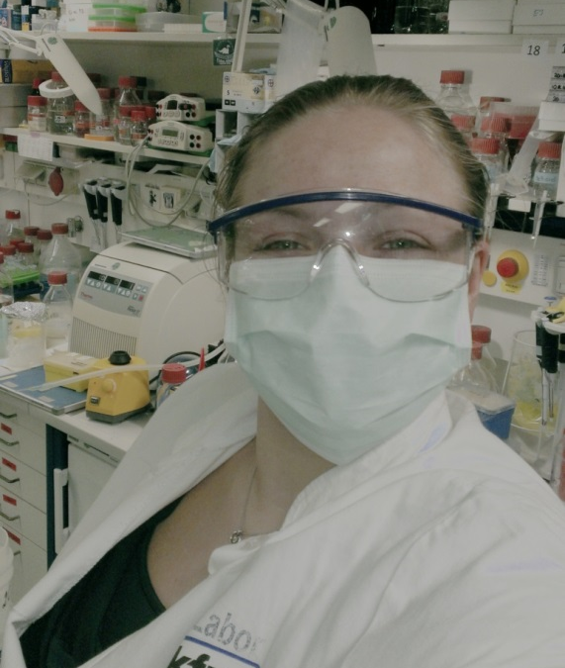
Who am I
@_adora_belle_
Biologist by training, Cancer Research
Science Blogger: scilogs.spektrum/lifescience
Podcast: zellmedien.de
Science Talks and Slams

Slide 4
How did I get here
Img: Taz.de
Notes:
2008, Schäuble, save fingerprints on ID Cards

Slide 5
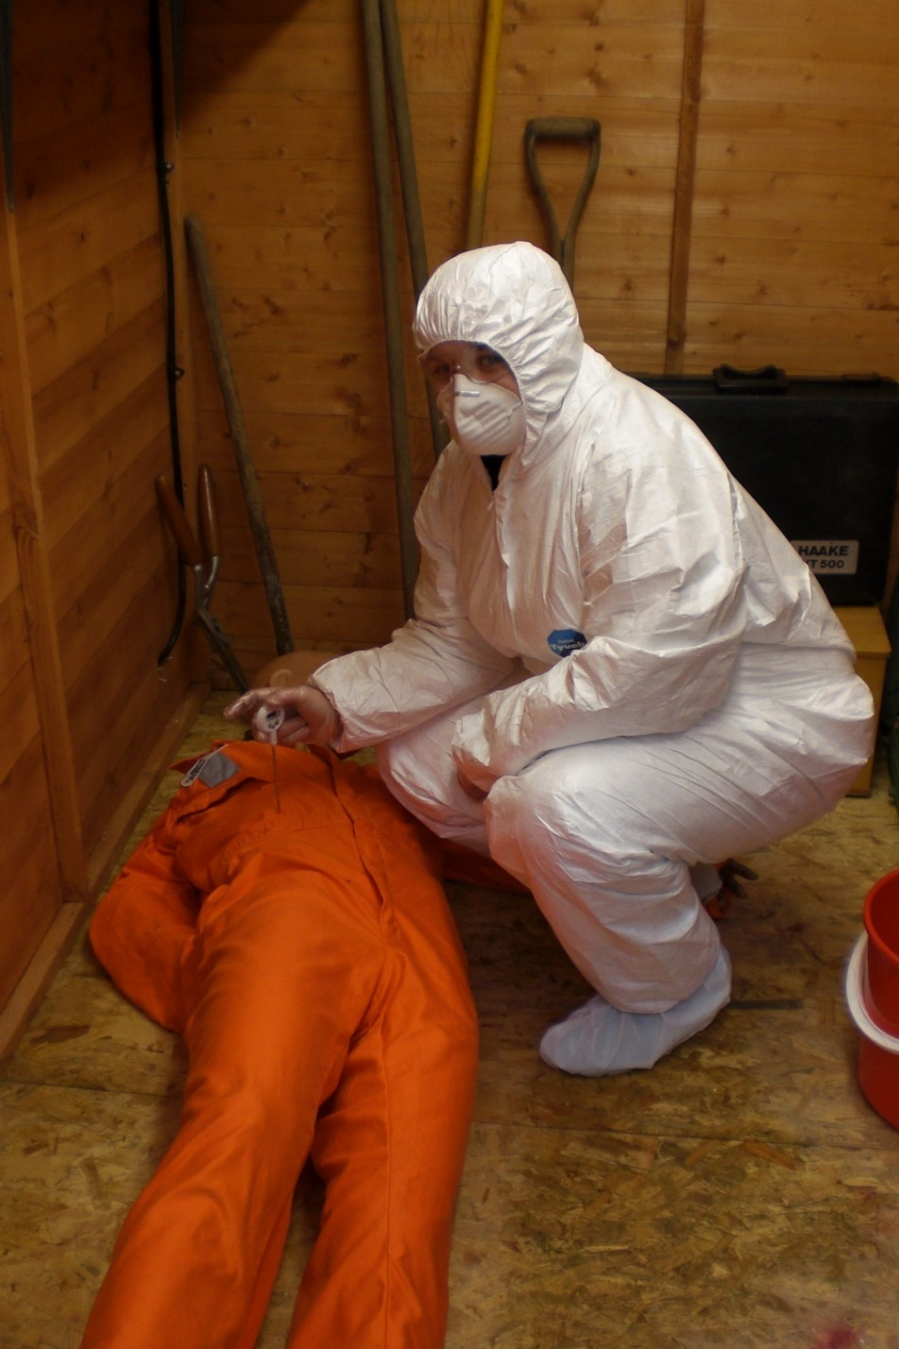
Notes:
Scotland, courses in forensics

Slide 6
Where do we find Genetic Information?
Just about anywhere.
Shed skin cells
Saliva
Blood
Hair
Urine
Feces
Sperm
Vaginal fluid
We spread our DNA all the time:
Toothbrush, brush, keyboard, cell phone, used condoms, on other people
Glasses we drink from
Letters
Cigarettes
Relatives

Slide 7
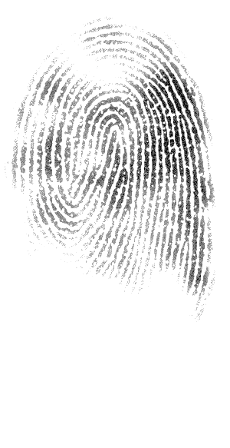
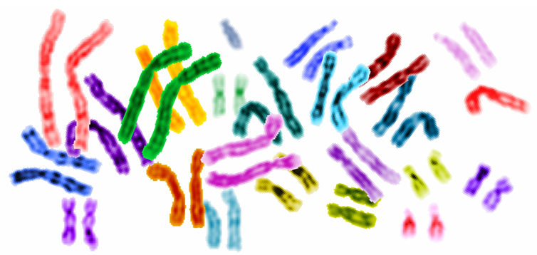
Genetic Fingerprints vs Whole Genome
Genetic Fingerprinting
Whole Genome Sequencing
No personal information
Biological gender
Possibility to find relatives
Re-Identification
Unique
Biological gender, ethnicity, genetic diseases, looks, relatives
Even more information to come
Re-Identification
Unique
CC by 2.0 Plociam

Slide 8
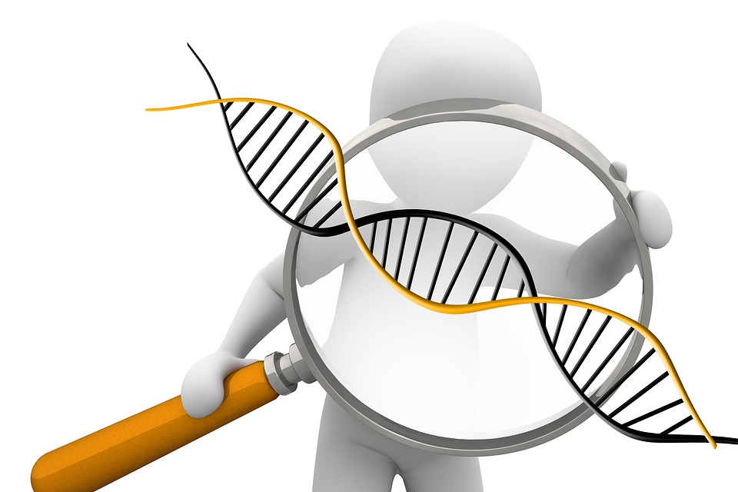
The Human Genome as a Final Frontier in Biology
Our DNA is what makes us us.
Or is it?

Slide 9
The Human Genome Project

Slide 10
Genomically, we‘re not that special
Expected 100.000 genes
„The language in which God created life“ Bill Clinton
19-20.000 Genes
Same number as nematodes
Just four times more than colon bacteria

Slide 11
„We don‘t know a shit“ (Craig Venter)

Slide 12
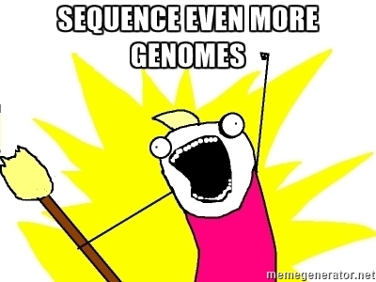

Slide 13
Finding Answers
Compare Genomes
1000 Genomes Project
10K Autism Genome Project
100K Genomes Project (UK)
1 Million Genomes Project (US)
Cancer Genome Project
Personalized Medicine
These will also not answer all the questions

Slide 14
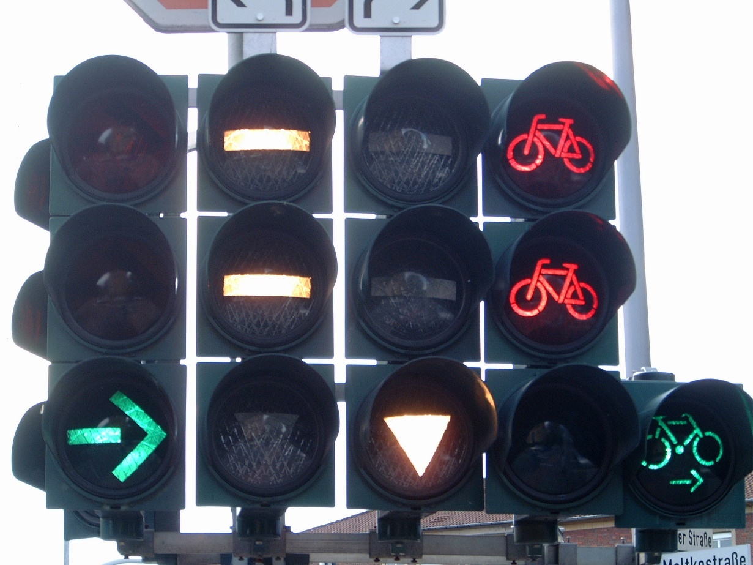
Interaction, Regulation and Environment
While DNA stays static, the regulation of the DNA varies widely
Notes:
It‘s all about Regulation
How our DNA is regulated is also important
Regulation is much more mobile/agile

Slide 15
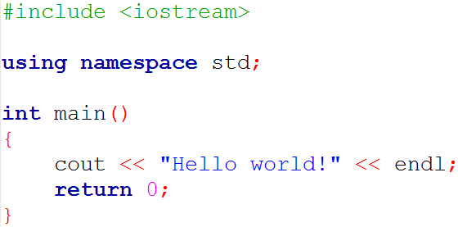
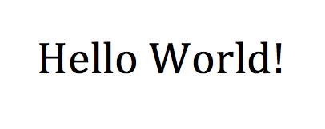
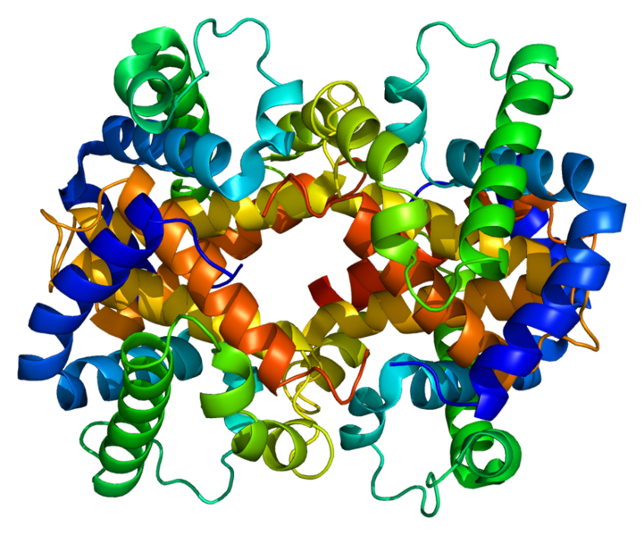
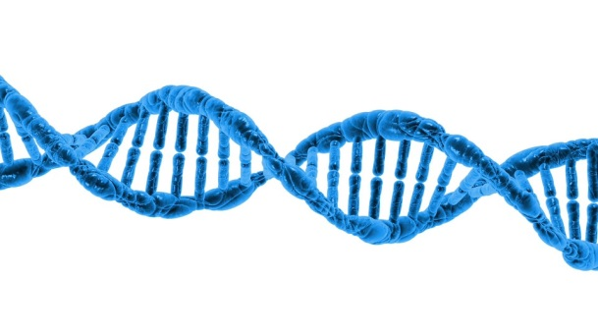
Our DNA is a code
Notes:
Dna is a code. Just like you write code and it‘s afterwards interpreted to show whatever, DNA codes for something.
In many cases, DNA is interpreted by the cellular components to form a protein. And these proteins are basically what make us funtion. They colour our skin, they create hair, muscle fibres, they are a means of communication and they greatly accelerate all kinds of processes. They govern cell division and, maybe most importantly, they govern the creation of other proteins. In the end, they are our DNAs GUI.

Slide 16
DNA codes for proteins which in turn regulate DNA
Notes:
So, in case you want to know how complex this is, this is just a tiny part of what happens in a cell all the time.
This is the cell, the nucleus, where the dna is.
These are all proteins interacting with each other.

Slide 17
Still, it does have its uses
Genetic Sequencing will still provide valuable information
But valuable for whom?
Whole Genome Sequencing could soon be used instead of specific tests because it has become cheaper
Possibility to study
Specific genes in a population
Genetic diseases
Inherited cancer
Genetic risks

Slide 18
Do we need Genome Sequencing
Diseased with Single-Gene Cause
Huntingtons, Cystic Fibrosis…
These are rare
Cancer Genes
if the gene is mutated, the individual will to a high likelyhood suffer from cancer at some (early) point in life
Breast/Ovarian Cancer
Colon Cancer
Special syndromes like Li-Fraumeni Syndrome
CC by 2.0 Stemoc

Slide 19
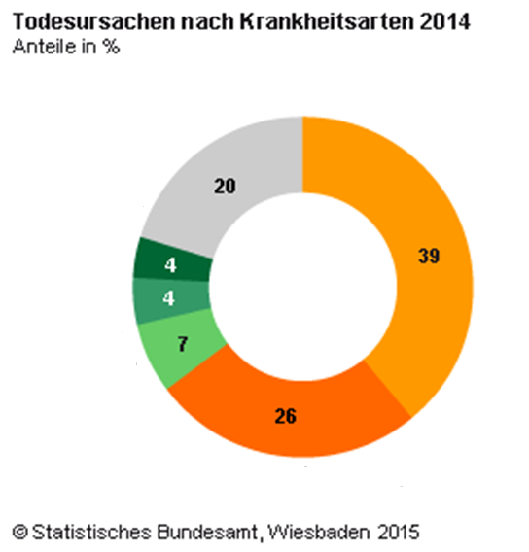
In the Western world we will probably die from...
Cardio Vascular Disease
Cancer
CVD
Cancer
Notes:
The thing about cancer

Slide 20
Main Way to not get cancer or CVD is to be boring
Healthy lifestyle
Radioactivity, UV
Screening
Cancer is mostly bad luck.
If you don’t get it, it means you’ve died of something else before you got it.
Genetic risk factors mostly play a very little role
Even then…
Notes:
No smoking, sports, healthy eating, low weight

Slide 21
Private Genetic Sequencing

Slide 22
Private Genetic Sequencing
23andme
Mail in genetic tests
Diseases and ethnicity
Sequence >500K locations
Ancestry
igenea.com “surname project”
Information on male lineage combined with last name
WGS: e.g.
Full Genomes Corporation, Guardiome, Gene by Gene
This means, they have quite some genetic information stored
Notes:
That‘s all nice and safe, since the government in America has of course repeatedly shown to respect privacy.

Slide 23
CC by 2.0 JimmyNeutron2016
Notes:
And of course, that wont change under the new president.

Slide 24
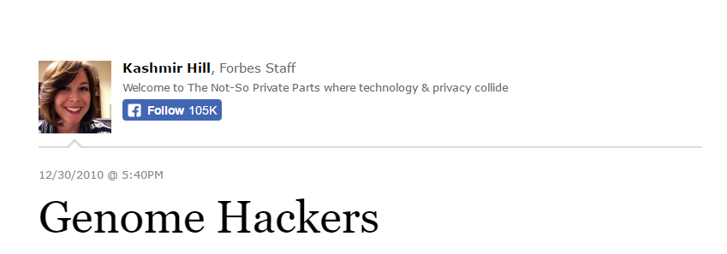
Kashmir Hill, 2010
Notes:
Interestingly, there has been surprisingly little talk about the privacy of genomes
However, some came quite early like this article
I quote:“As gene tests become common, possibilities for abuse will intensify. Banks might not offer you a mortgage if you were likely to die before it was paid off. A pregnant women might secretly get DNA from her lovers so she knows who the father is. Someone might check out a potential mate for genetic flaws. Politicians might dig up dirt on their rivals. Another question: How far should law enforcement be allowed to go? Should prosecutors be allowed to subpoena a company's DNA database of thousands of people if they suspect it contains a match to a crime suspect?”

Slide 25
Robert Langreth, 2011
Notes:
“I think this issue is just starting to emerge. It will be a classic conflict between scientists desire for more data and Americans desire to keep sensitive personal information private. If your DNA is in an easily accessible database, what are the limits of what bureaucrats can do with it?”

Slide 26
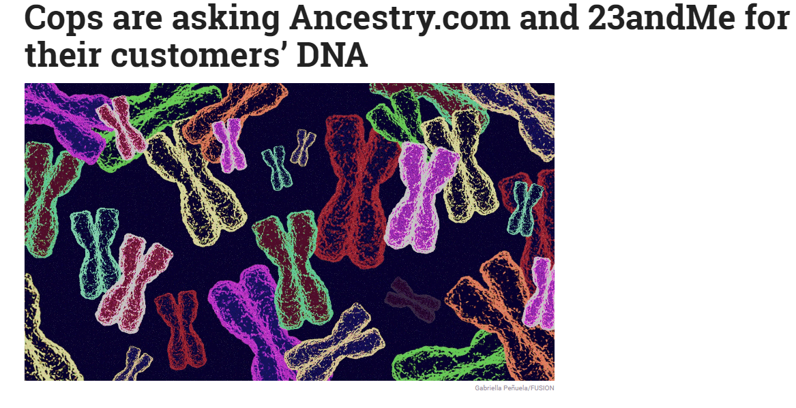
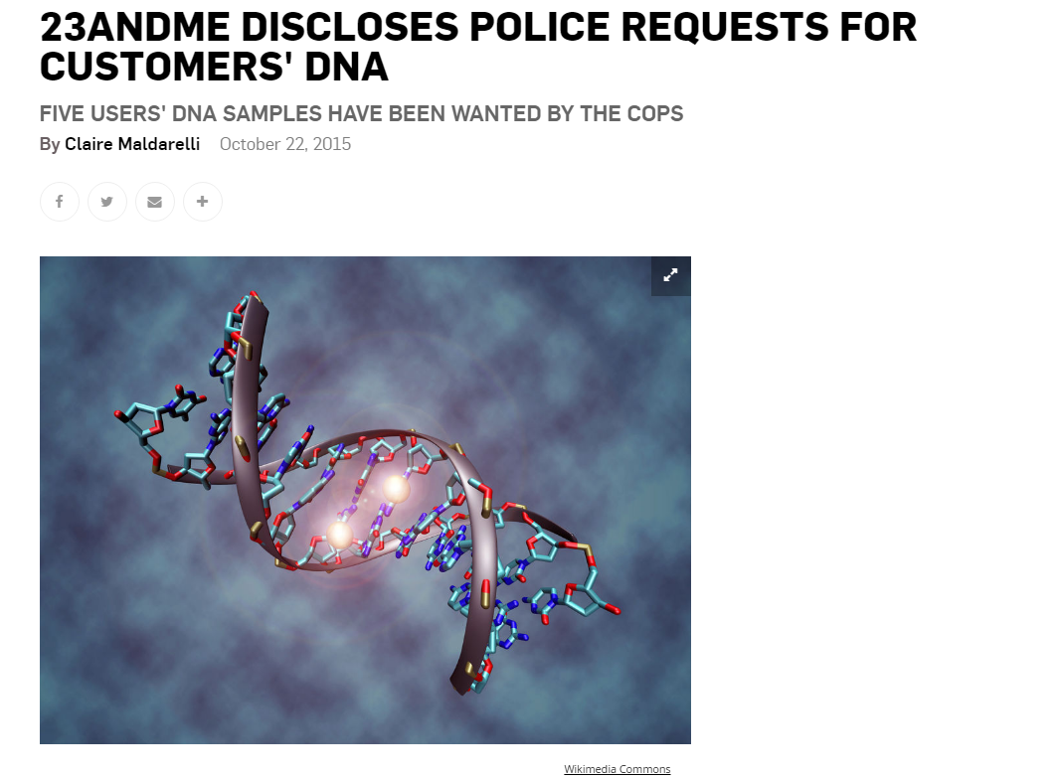
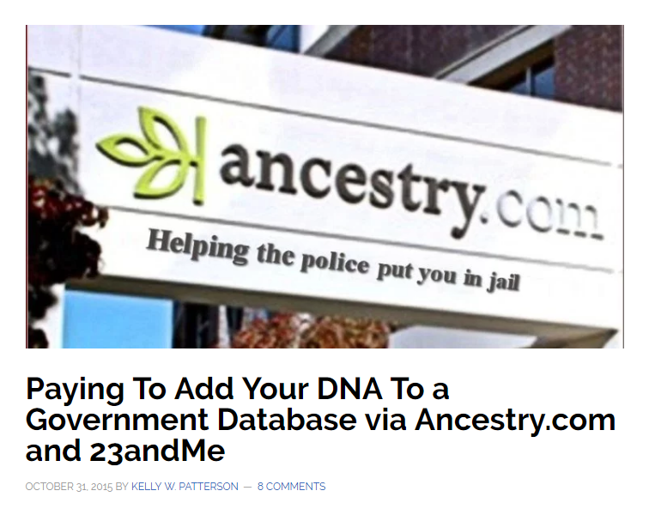
The usual suspects
Notes:
Subpoena - Vorladung

Slide 27
It‘s already happening
DNA on a murder victim
Voluntary Y-chromosome-database search
The database lists family names
Y-chromosome is the male sex chromosome
The murderer was related in the male line to a to filmmaker Usry
Complete DNA did not match
Notes:
Court order for ancestry.com, father‘s DNA suggested murderer was a relative of him
Kate Black, Privacy officer 23andme: “In the event we are required by law to make a disclosure, we will notify the affected customer through the contact information provided to us, unless doing so would violate the law or a court order.”

Slide 28
Kate Black, privacy officer 23andme: “In the event we are required by law to make a disclosure, we will notify the affected customer through the contact information provided to us, unless doing so would violate the law or a court order.”

Slide 29
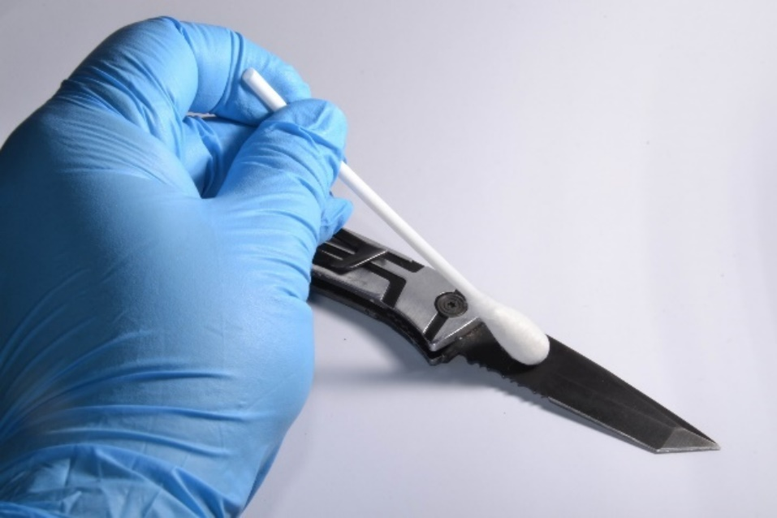
„I‘ve got nothing to hide“
Planted evidence
Circumstancial evidence
The phantom DNA
Heilbronn Phantom (UwP)
Img: CC by SA 4.0 Daekow
Notes:
Juan Rivera (planted evidence)

Slide 30
(Genetic) Data is the new oil
23andme has reportedly sold the genetic data to private companies
They have 1.2 million genetic profiles stored (2016)
More deals planned
Anne Wojcicki: „I want the world's [health care] data accessible.”
About 80% of customers sign consent form
Do they know what they are getting into?
Notes:
Many say „do whatever it takes“ to counteract disease
Is it the right strategy?

Slide 31
Genetic Sequencing privacy

Slide 32
Is a Genome interesting?
Since you send your DNA-probe in by mail, there is no way to know if it is your own DNA
Who would be interested in your genes?
Prospective partners
Family members (fidelity, paternity, adoption)
Insurance companies
Employers
Prospective parents (pre-implantation diagnostics)
Who knows…

Slide 33
The Price
Genetic Test from 23andme: 199 US$
Price of Whole Genomes is now below 1000 US$
The price will decrease further

Slide 34
Example One: who’s your daddy?
23andme connected a man to his biological father via his biological cousin
Notes:
Did the father want to be found?

Slide 35
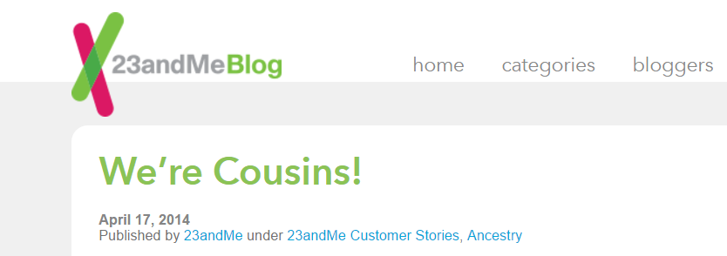
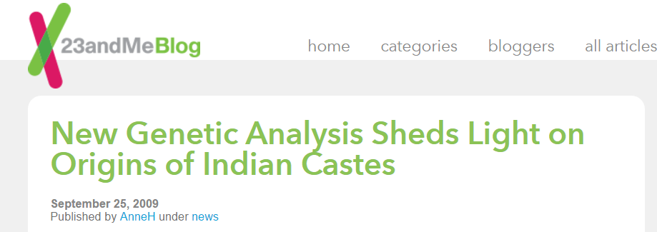
Example Two: Faith
Notes:
This is no information that is in any way bad. But if could have been and it might be again.

Slide 36
Example Three: Kuwait
Plans Genetic Testing at the border
Claim: Anti-Terrorism
Could be due to: Keep out non-Kuwaitis
Beduins
Genetic Testing of (Non)-Family members
Notes:
(not feasible, why would you have terrorist DNA?
Illegitimate children
Unfaithful wives
Genetic flaws
Heritage

Slide 37
Getting your Whole Genome Sequenced
http://blog.mlin.net
Notes:
https://www.wired.com/2013/10/big-data-biology/
http://blog.mlin.net/2014/03/blogging-my-genome-episode-3-data.html

Slide 38
Genetic Data CAN be useful
...but it can be heavily misused!
But they do have relevance in research
There is a large amount of genomes stored for research purposes at many institutes
David Goldstein, Institute for genome medicine at Columbia University:
Irreversible drive toward obtaining more and more complete genetic information
“We are all going to be sequenced; the question is just who does it and what is done with it. The challenge will be to do good things with the data.”

Slide 39
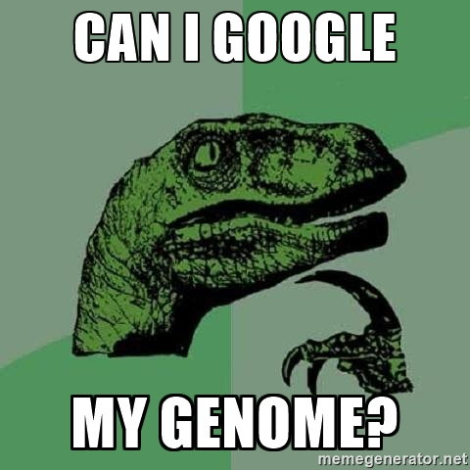
Sharing data
Genomes need to be compared
Data Size is a Problem:
Genomes can be up to 200GB large
Depends on coverage (i.e. data quality)
The 1000 Genomes Project
200TB in AWS cloud
Google Genomics
Big Data of Genomes
A lot of private companies are interested in genomes
Notes:
http://www.wbur.org/npr/447202433/-great-pause-among-forensic-scientists-as-dna-proves-fallible
https://medium.com/precision-medicine/how-big-is-the-human-genome-e90caa3409b0#.7saobual5

Slide 40
Is it worth it?

Slide 41
Genome Research
Genetic tests make sense
For research purposes
To adjust treatment of diseases (e.g. cancer, autoimmune)
Works to a point
Forensics (but in which limits)
Genetic tests are not necessary
Does your ancestry really matter so much?
It’s not just YOUR information
Do you really want to know what the test tells you?
You cannot change your DNA

Slide 42
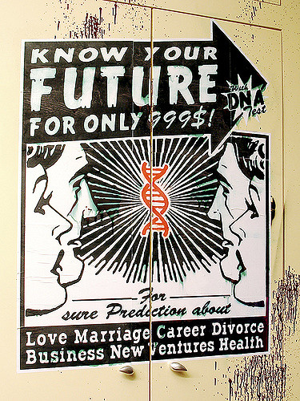
That‘s all folks
©Thierry Ehrmann on flickr.

