Slide 1
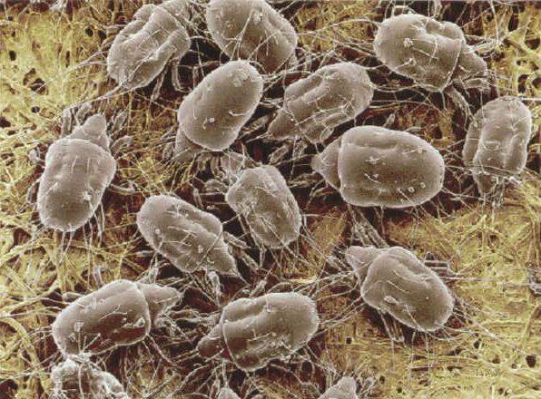
A collection of random things: Look what I found under the carpet
Ilja van Sprundel
ilja@netric.org

Slide 2
Who am I
Loves to see things crash
IOActive
Netric
http://blogs.23.nu/ilja
http://ilja.netric.org/

Slide 3
Agenda
/dev/[k]mem race conditions
Snprintf corner cases
Using Out-Of-Band data to avoid ids
Tcp stack fuzzer

Slide 4
Introduction
Style somewhat like my unusual bugs talk
No big secrets
Mostly old, obscure and undocumented things

Slide 5
/dev/[k]mem race conditions

Slide 6
/dev/[k]mem race conditions
/dev/[k]mem is a virtual file
Represents all of kernel memory as a file
Is used to grep data out of the kernel
Statistics
Information about processes
Information about the network
Loaded kernel modules
Load average
….
Only root and group kmem can read it (for obvious reasons)
Usually done with sgid kmem programs

Slide 7
/dev/[k]mem race conditions
Some potential problems arise
Most of the time multiple read calls are needed
Can’t lock kernel data structs from userland
Can lead to potential synchronisation issues

Slide 8
/dev/[k]mem race conditions
Simple example: print the name of a process
Step 1: find the process table
Step 2: find the right process structure
Step 3: find the pointer in there that points to the name of the process
Step 4: get the string it points to.
Step 5: print it.
Race between step 2 and 3.
What if that process vanished in between ?

Slide 9
/dev/kmem race conditions
Attacking this:
Between step 2 and 3
Process structure gets free’d
Same memory gets reallocated in the kernel
Attacker has control over that content
Lay it out so that if it were a process struct you’d have the process name pointer point to some piece of data you want to leak
(tty buffer, buffer cache, ….)

Slide 10
/dev/kmem race conditions
The race might seem small
But it’s fairly easy to make the race window arbitrarily long
Send sigstop to the sgid process at the right time. (this pauses the sgid process)
Lay everything out correctly
Send sigcont to the sgid process.

Slide 11
/dev/kmem race conditions
This issue’s been around for a _long_ time.
Noone ever raised a big stink over it.
Clearly some people must have known
Can’t find any public references about this
People are moving away from this
And use sysctl or proc file system
Makes much more sense

Slide 12
/dev/kmem race conditions
Mostly seen in the BSD’s.
Taken a look at NetBSD
It has a bunch of apps that read data out of /dev/kmem
Some of them use /dev/kmem, some systcl
The majority use both
Since sysctl can’t yet provide all info that’s needed

Slide 13
/dev/kmem race conditions
Uses a library for most of this
Libkvm
Uses /dev/kmem historically
Modified to use sysctl whenever possible
Mostly when libkvm api’s are used sysctl is used
kvm_getprocs(), kvm_getproc2(), kvm_getargv(), …

Slide 14
/dev/kmem race conditions
Things start getting bad when the direct read api’s are used
Kvm_read() in particular
When used on the running kernel, you end up with race conditions
It can also operate on core files and swap files.

Slide 15
/dev/kmem race conditions
Apps that’s that use both /dev/kmem and sysctl
Vmstat
Trsp (not used on the running kernel)
Trpt (not used on the running kernel)
Pstat
Fstat
Slstats
Ccdconfig
Systat
Netstat
pmap

Slide 16
/dev/kmem race conditions
Most of those apps do privdrops as soon as possible
Drops privs immediately if not grepping data out of the running kernel
Except for
Trsp
Trpt

Slide 17
/dev/kmem race conditions
Libkvm and these sgid apps are build under the assumption that the kernel can be trusted
If you get to feed it a (malformed) core file, that assumption goes away
Same with the race conditions
Libkvm really doesn’t stand up well to random crap being parsed

Slide 18
/dev/kmem race conditions
Example:
char *
kvm_getfiles(kd, op, arg, cnt)
kvm_t *kd;
int op, arg;
int *cnt;
{
...
... KREAD(kd, nl[0].n_value, &numfiles) ...
size = sizeof(fhead) + (numfiles + 10) * sizeof(struct file); <-- int overflow
KVM_ALLOC(kd, argspc, size); <-- alloc too small
numfiles = kvm_deadfiles(kd, op, arg, (long)nl[1].n_value,numfiles); <-- overflow
...
}

Slide 19
/dev/kmem race conditions
When looking into this …
I found some other issues.
Was reading systat code.
It has a signal handler
Which is not safe at all
Doesn’t seem to affect FreeBSD or OpenBSD.

Slide 20
/dev/kmem race conditions
src/usr.bin/systat/main.c
static void
stop(int signo)
{
sigset_t set;
signal(SIGTSTP, sv_stop_handler);
/* unblock SIGTSTP */
sigemptyset(&set);
sigaddset(&set, SIGTSTP);
sigprocmask(SIG_UNBLOCK, &set, NULL);
/* stop ourselves */
kill(0, SIGTSTP);
/* must have been restarted */
signal(SIGTSTP, stop);
redraw(signo);
}
One liner poc:
while [ 1 ] ; do kill -TSTP <pid>; kill -CONT <pid>; kill -TSTP <pid>; done

Slide 21
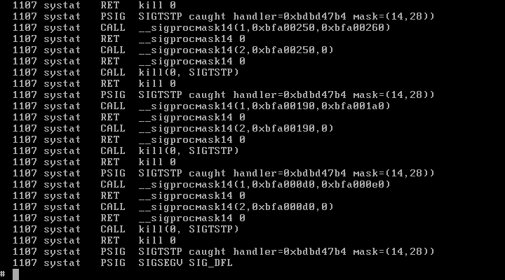
/dev/kmem race conditions

Slide 22
/dev/kmem race conditions
Reading some of the kvm manpages online
Xss in the webform
Html code gets escaped
But incorrectly
No &gt; and the like
But escaped with a \ ☺

Slide 23
Snprintf corner cases

Slide 24
Snprintf corner cases
Snprintf is the more secure version of sprintf
Its behavior is described in the c99 standard
It has a couple of corner cases
Some of which are implementation dependant

Slide 25
Snprintf corner cases
Snprintf’s return value, when successful is simular to sprintf’s
It returns how many bytes got written ….
… had there been no bounds check !
Is guarenteed to be 0-terminated …
… unless the input length is 0 (duh)

Slide 26
Snprintf corner cases
Snprintf can fail
In which case it returns -1
What if you don’t catch that error ?
The string is not guaranteed to be 0-terminated.

Slide 27
Snprintf corner cases
Return value often gets abused.
Increase the pointer with it:
Incase of the boundscheck being hit, you now have a pointer pointing outside of the buffer it points to
Incase of an error, the pointer actually gets decreased, something you probably didn’t want

Slide 28
Snprintf corner cases
Making snprintf fail
In glibc, under certain locals, snprintf will try to do some kind of unicode detection.
If the input then turns out to be broken, snprintf will fail and return -1
You could also use this unicode conversion to to bypass certain filters

Slide 29
Snprintf corner cases
The whole idea of encoding 3 different things in a return value is a bit silly imo
Failed or not failed would be better

Slide 30
Snprintf corner cases
It seems the redhat guys completely broke their snprintf implementation in fc7!!
The return value will _always_ be equal to the size given as input
How can that even work ?
Apps break on this !

Slide 31
Using Out-Of-Band data to avoid ids

Slide 32
Using Out-Of-Band data to avoid ids
Out-of band data in tcp is usually used to signal for something
Set the urg flag, and the pointer offset.
1 out-of-band byte per packet.
Pretty obscure feature
Noone uses it anymore these days
And noone remembers how to use it

Slide 33
Using Out-Of-Band data to avoid ids
Most descriptions out there on how to handle Out-of-band data really sucks
They’re bad copies of what stevens said

Slide 34
Using Out-Of-Band data to avoid ids
Sending oob data is simple
Send(fd, data, len, MSG_OOB);
Receiving it depends on what you want to do
What happens by default ?

Slide 35
Using Out-Of-Band data to avoid ids
By default
Nothing should happen
It gets discarded
You need to let your kernel know you want to receive it.
You do this by telling it you (your pid) owns the fd you’re going to receive oob data from
Fcntl(fd, F_SETOWN, getpid())

Slide 36
Using Out-Of-Band data to avoid ids
Once that is done, whenever oob data arrives you’ll get a sigurg send.
If you don’t set the OOB_INLINE socket option, the oob data is kept out of band
To retrieve it out of band you can do
Recv(fd, buf, len, MSG_OOB)
You can also set the OOB_INLINE socket options, and receive the oob data inline

Slide 37
Using Out-Of-Band data to avoid ids
Older linux kernels just put the Out-Of-Band data inline by default
Newer 2.6 kernels don’t do this anymore
Allows you to sneak in data that the ids wouldn’t notice

Slide 38
Using Out-Of-Band data to avoid ids
Besides this oob handling in older linux kernels, handling oob data is very much application specific
And ids can really never know how exactly it’s going to be used.

Slide 39
Using Out-Of-Band data to avoid ids
Some other interesting issues that could and did happen with oob handling
When doing fcntl(fd, F_SETOWN, <pid>)
Set it to a pid of a root owned process.
Get recv oob data
Now get to send signals to a process you’re not supposed to send signals too
Fixed in most unices a while ago
Who knows, some might still be vuln

Slide 40
Using Out-Of-Band data to avoid ids
Oob data can be used to remotely deliver a signal
Might cause signal race conditions
Depends if the application’s sigurg hander is well written or not
Somewhat related:
In linux, in certain situations, you can get the oom killer to send signals for you remotely (if you can exaust enough memory).

Slide 41
Using Out-Of-Band data to avoid ids
http://mail-index.netbsd.org/tech-security/1997/09/15/0000.html
http://www.openbsd.org/advisories/signals.txt
http://lcamtuf.coredump.cx/signals.txt

Slide 42
Tcp stack fuzzer

Slide 43
Tcp stack fuzzer
Raincheck
Yes, I’m a slacker
There is code, its not functional ….
Maybe next year ?

Slide 44
Q&A ?

