Slide 1
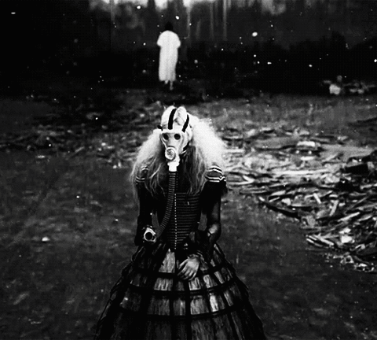
/studying millennials and gender in european F/LOSS subcultures
/she_hackers.
Notes:
Major testies

Slide 2
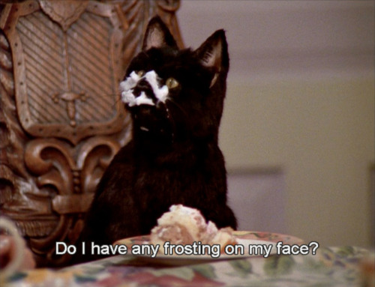
hi guys. i’m @kat_braybrooke.
Notes:
Totally

Slide 3

how I fell down the wormhole.
secret: I’m into hackers.

Slide 4
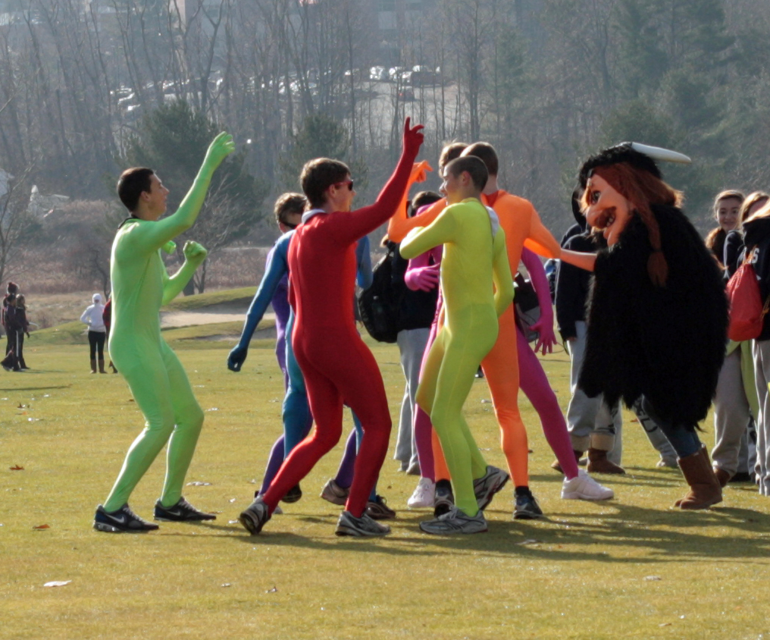
a note on terminology.
what the hell is a ‘geek’?

Slide 5
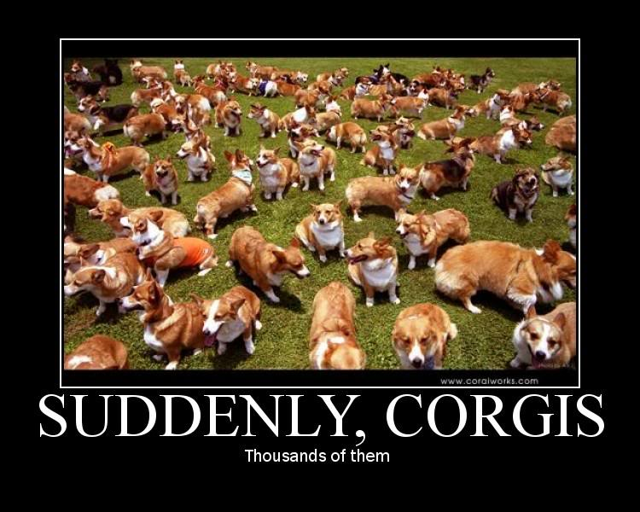
this is the part where i try to
sound like an academic.

Slide 6
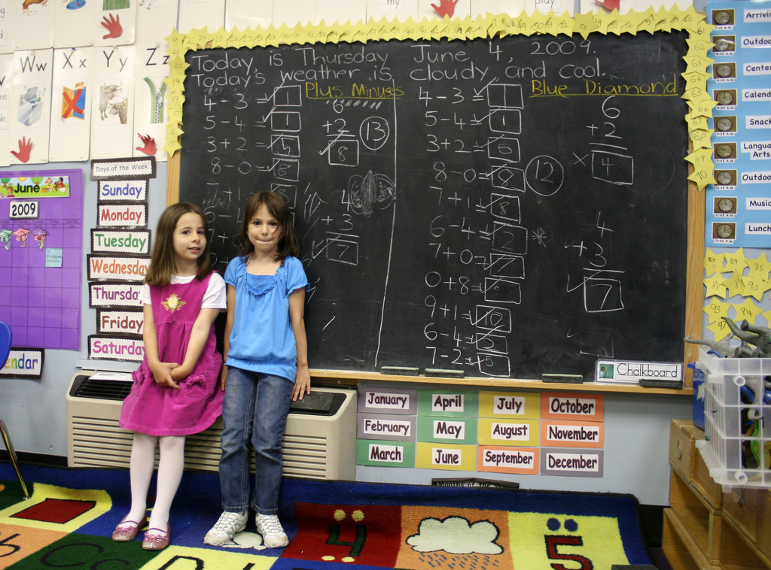

but why anthropology?

Slide 7
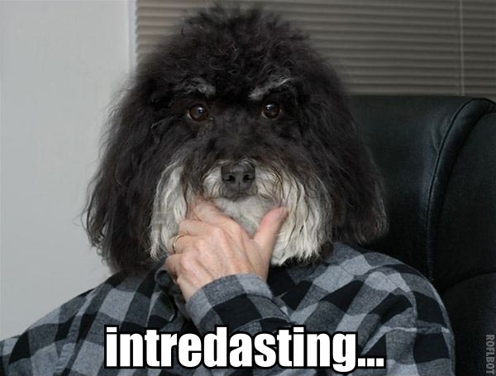
and now, the research.

Slide 8
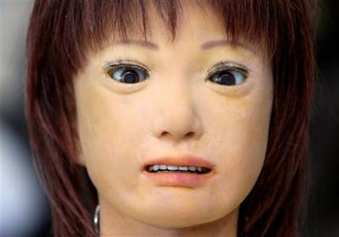
get to the f*king point!
what were the results?

Slide 9
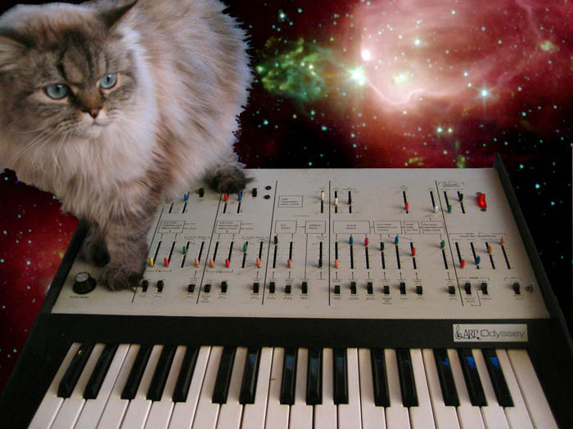
and this is the part
where i force you
to hang out w me.

Slide 10
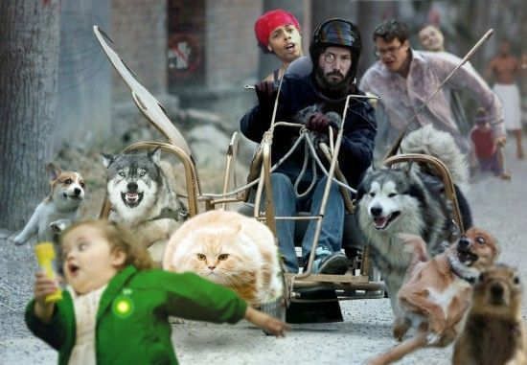
thanks, #cccamp.
you rule.

